Slide 1

“Vehicle Service Application ”
Project Supervisor: MS.R.YOGITHA
Name of the Student: K.Abhinav
Register Number: 41110666

Slide 2
Presentation Outline
Course Certificate
Introduction
Objectives
System Architecture / Ideation Map
Module Implementation
Application Snapshots
Results and Discussions
Conclusion & Future work
References

Slide 3
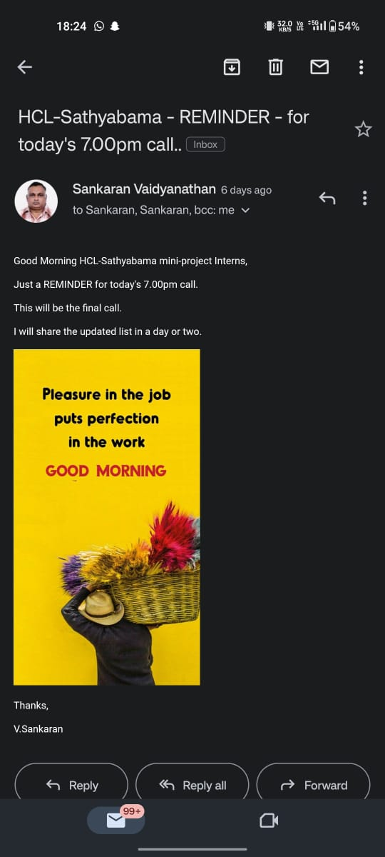
Course Certificate

Slide 4
Introduction
A vehicle service application project is a software development project that aims to create a mobile or web application that helps users book and manage vehicle services. This can include a wide range of services, such as oil changes, brake repairs, tune-ups, and more.
Vehicle service applications can offer a number of benefits to users, including:
Convenience: Users can book and manage services 24/7 from their smartphone or computer.
Transparency: Users can see pricing and service details upfront.
Peace of mind: Users can feel confident that their vehicle is being serviced by qualified professionals. And many more.
Here are some of the key features that a vehicle service application should include:
Online booking: Users should be able to book services online or through the app.
Service history: Users should be able to view their vehicle's service history and track upcoming appointments.
Push notifications: Users should receive push notifications for upcoming appointments and service reminders.
Payment processing: Users should be able to pay for services directly through the app.
Customer support: Users should be able to contact customer support directly through the app if they have any questions or problems

Slide 5
Objectives
The objective of a vehicle service application is to provide a convenient, affordable, and efficient way for vehicle owners to schedule and manage their vehicle service appointments. The app should also provide users with access to information about different service providers, their prices, and their reviews.
In addition to these specific objectives, a vehicle service application should also be:
Customer-centric: The app should be designed with the user in mind, making it easy to use and navigate.
Reliable: The app should be accurate and up-to-date, providing users with the information they need to make informed decisions about their vehicle service.
Secure: The app should protect user data and privacy.
Overall, the objective of a vehicle service application is to help vehicle owners save time and money while keeping their vehicles in good condition.

Slide 6
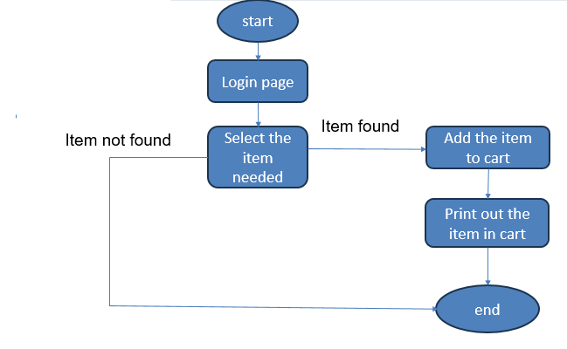
System Architecture/ Ideation Map
11 November 2021
Department of CSE
6

Slide 7
Project Implementation
Define the scope of your project:What features do you want your application to have? What type of users will be using it? And what are your budget and timeline constraints?
Design your application:This includes creating wireframes and mockups to visualize how your application will look and function. You will also need to design your database and backend infrastructure.
Develop your application: This is where you will write the code for your application. You can use a variety of programming languages and frameworks, depending on your specific needs.
Test your application: Once you have developed your application, you need to test it thoroughly to make sure that it works as expected. This includes testing all of the features of your application, as well as testing it with different types of data and devices.
Deploy your application: Once you are satisfied with your application, you need to deploy it so that users can start using it. This may involve deploying your application to a web server, or publishing it to an app store.

Slide 8
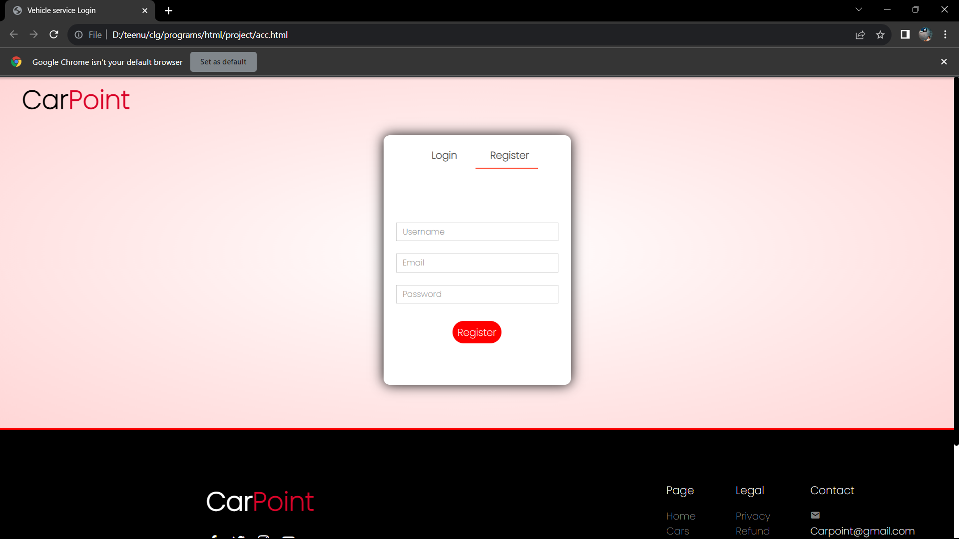
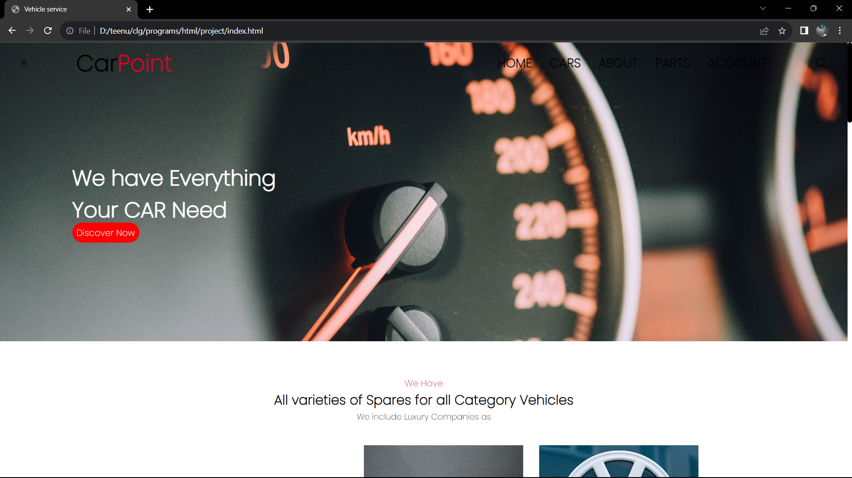
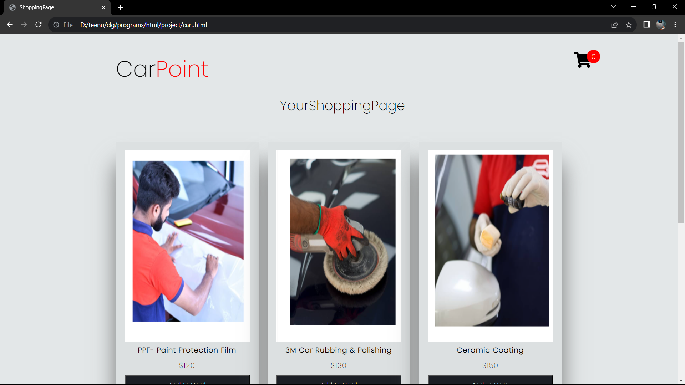
Sample Snapshot

Slide 9
Results and Discussion
Vehicle service applications can deliver a number of benefits to both vehicle owners and vehicle service providers.
Convenience.
Transparency.
Peace of mind.
Increased efficiency.
Improved customer service.
Increased revenue.
Allow customers to discuss their service needs with a technician before the service is performed. This can help to ensure that the customer's needs are clearly understood and that the technician is able to provide the best possible service.

Slide 10
Conclusion
In conclusion, this project has developed a vehicle service application that provides a number of benefits to both customers and service providers. The application allows customers to easily book appointments, track the status of their vehicles, and receive notifications about upcoming services. It also allows service providers to manage their calendars, track inventory, and generate invoices

Slide 11
References
Vehicle Service Application Project Report by RNEC Vehicle Service
Online Vehicle Service Center Management System by Visvesvaraya Technological University
Online Vehicle Service Station Management System by SlideShare
The Vehicle Service Management System by Research Gate
Application used in vehicle service application by Bard (me!)
Go Mechanic Application by
Amit Bhasin
Kushal Karwa
Rishabh Karwa
Nitin Rana in 2016

Slide 12
THANK YOU

